Slide 1
Historical Background Differences:
A Summary of their impact on the HIV/AIDS Epidemic in South Africa and Botswana
-Luke Jett

Slide 2
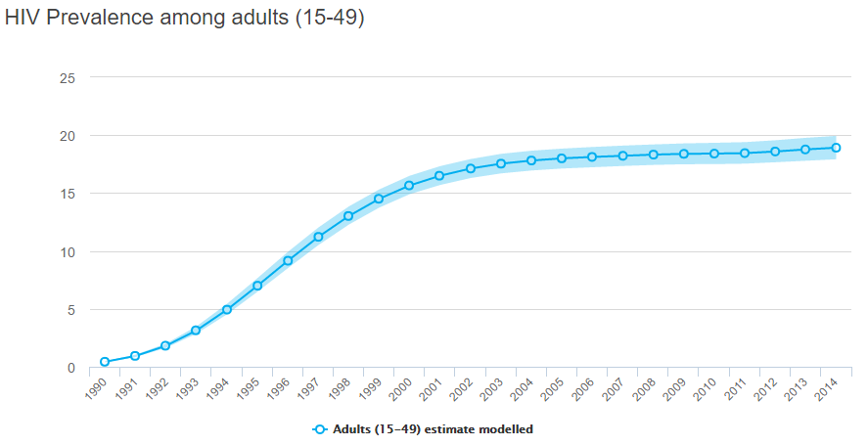
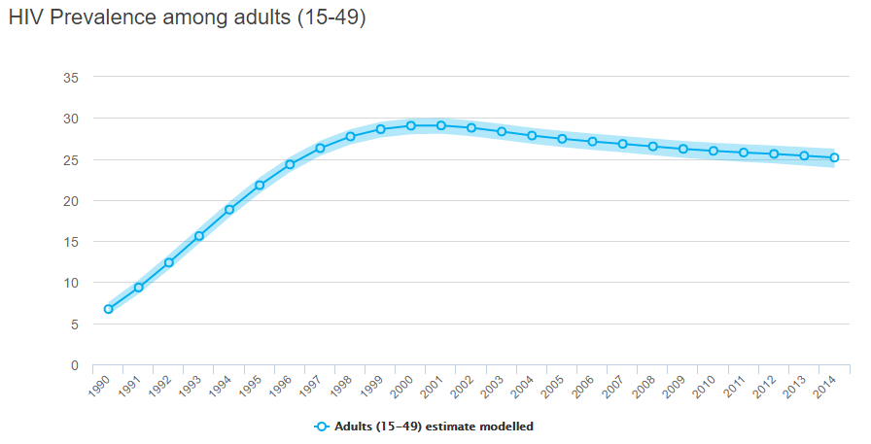
Present Day Statistics
South Africa
GDP: 350.6 billion USD
Botswana
GDP: 14.78 billion USD

Slide 3
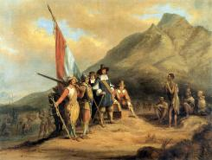
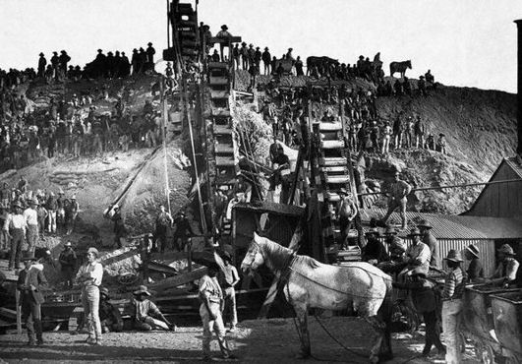
History of South Africa
Indigenous people known as Khoikhoi
April 6th, 1652 marks the arrival of Jan Van Riebeeck
Cape Town Colony Established

Slide 4
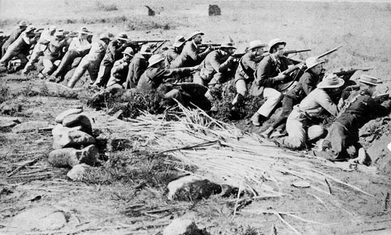
The Boer War
1899 Conflict between Dutch Republics and British Colonies
Guerilla style war led to the destruction of many Boer Farms, Concentrations Camps
Racial Tensions increased

Slide 5
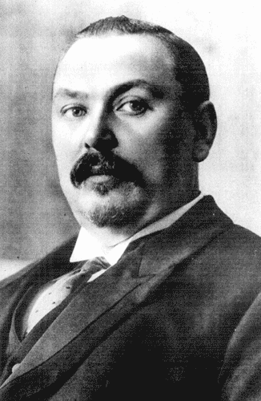
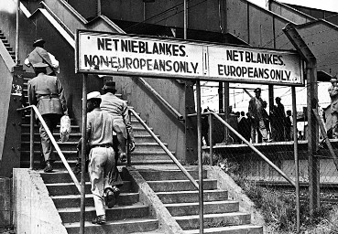
Apartheid
Act of 1909 formed Union of South Africa
General Louis Botha “elected” president
Apartheid- separation of races
WWI increases racial tensions

Slide 6
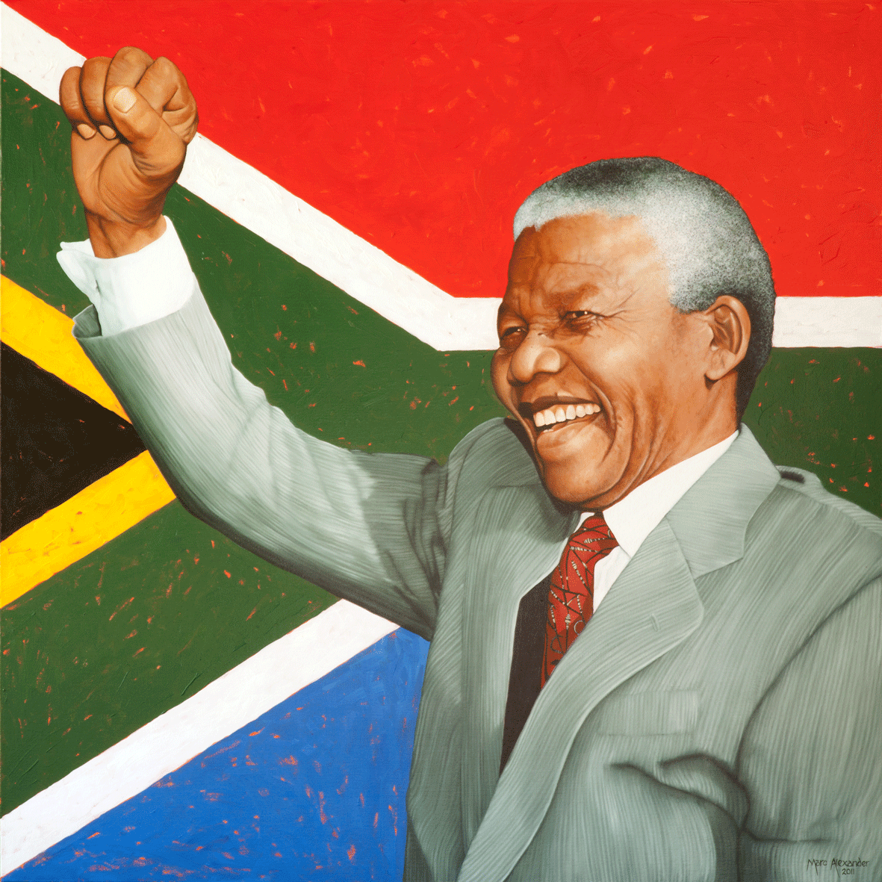
Nelson Mandela and a New Era
Feb. 11, 1990 Nelson Mandela Released from Prison
Adopted some of Mahatma Gandhi's peaceful protest tactics
Elected President in 1994

Slide 7
History of Botswana
San and Khoe Societies formed earliest Batswana socities
18th Century – eight principalities - Republic of Botswana
End of the 19th Century – British Protectorate- Bechuanaland

Slide 8
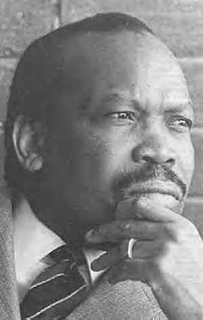
Botswana- Complete Self Rule
Sir Seretse Khama led the formation of the Bechuanaland Democratic Party (BDP) in 1962
Elected prime minister in 1965
Granted independence in 1966

Slide 9
Early Epidemic – South Africa
First deaths from AIDS in 1985 during Apartheid Rule
Harsh mandatory Quarantine
Derogatory Claims by White leaders dominated political atmosphere

Slide 10
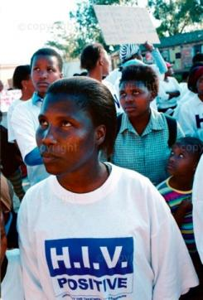
Mandela Administration
HIV/AIDS epidemic addressed as focus for government administration
March 1994 International Conference for People Living with HIV and AIDS
Failure of Sarafina II
Treatment Action Campaign (TAC)

Slide 11
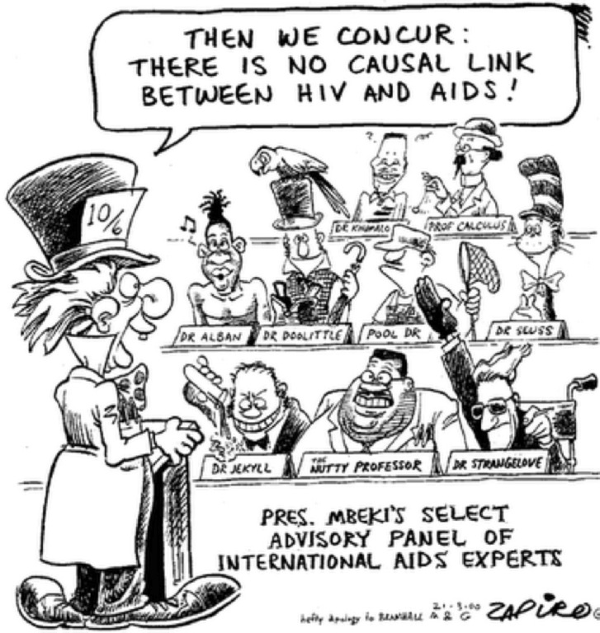
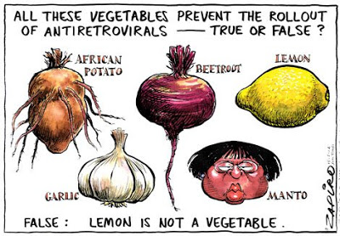
Thabo Mbeki Administration
Outright Denial of HIV connection to AIDS
Manto Tshabalala-Msimang appointed as Minister of Health
2001 High Court Mandated Nepravine be made available to HIV-positive pregnant women
2003 plan for universal ARV treatment revealed

Slide 12
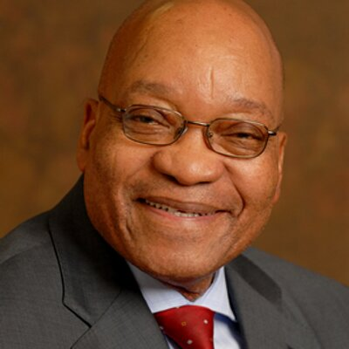
Present Day Actions- South Africa
2009- Jacob Zuma elected president
Anti-retroviral Therapy (ART) becoming more common place
Campaigns to address the epidemic underway
Still facing education gaps, and social stigmas

Slide 13
Early Epidemic in Botswana
First case in 1985
As infection rate increased Botswana Government launched several programs emphasizing key areas:
Education
Prevention
Treatment
Focus on addressing HIV/AIDS as Public Health Issue

Slide 14
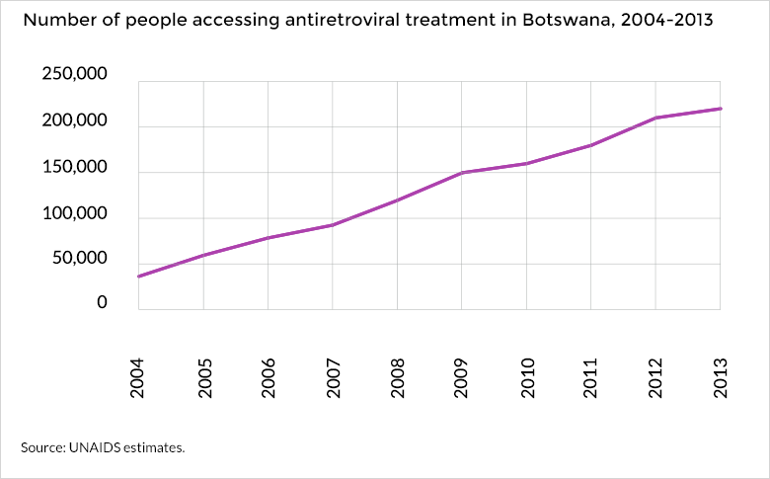
Present Day- Botswana
In 2002 Botswana launched ART program on a national level
Increased internal and external funding
Continued decrease in
national prevalence

Slide 15
Present Day Statistics
South Africa
GDP: 350.6 billion USD
Botswana
GDP: 14.78 billion USD

Slide 16
The Take Away
Effects of Stigmatism and Prejudice on Treatment
Education as a Primary Obstacle
Promising findings following an aggressive and dedicated approach to ending HIV/AIDS as an epidemic
Impact of economic Wealth on Treatment and Prevention

Slide 17
References
McNeil, J. “A History of Official Government HIV/AIDS Policy in South Africa”. SAHO. 2012.
“From Access to Adherence: The Challenges of Antiretroviral Treatment”. WHO. 2006. Chapter 2.
“HIV and AIDS in Botswana”. Avert. 2015, http://www.avert.org/professionals/hiv-around-world/sub-saharan-africa/botswana
UN AIDS Website, South Africa and Botswana Pages

